Slide 1
Module 1: Introduction to Microsoft Azure Backup
Section 1: Product Overview

Slide 2
Section Objectives
After completing this section, you will be able to:
Articulate the challenges that Microsoft Azure Backup solves
Understand what Microsoft Azure Backup does
Identify Key Features in Microsoft Azure Backup
Be aware of Supported Platforms and Unsupported Scenarios

Slide 3
Data Protection Challenges
Rapid Data Growth
Data rates are growing at rapid growth per year
Important data may go without the protection it should have
Operation Challenges
Cost of storage growing
Cost of backup solutions
Complexity of managing all that storage

Slide 4
Microsoft Azure Backup
Simple and reliable server backup to the cloud
Reliable offsite data protection
A simple and integrated solution
Efficient backup and recovery
Convenient offsite protection
Safe data
Encrypted backups
Familiar interface
Azure integration
Efficient use of bandwidth and storage
Flexible configuration
Flexibility in recovery
Cost-effective and metered by usage
Notes:
Microsoft Azure Backup Service offers IT administrators the option to back up and protect critical data in an easily recoverable way from any location.
The Microsoft Azure Backup Service provides a new way to deliver business continuity benefits to Windows Server 2012 customers by providing a backup solution that requires no upfront hardware cost.
System Center 2012 SP1 Data Protection Manager customers get the added option to select online backup as a short-term recovery goal.
Microsoft Azure Backup is a cloud-hosted backup solution that provides file and folder backup capabilities for Windows Server 2012, Windows Server 2012 R2 and Windows Server 2008 R2 computers.
The Microsoft Azure Backup Agent can back up either files or folders. Customers can use system Center 2012 SP1 Data Protection Manager to back up File/volume, SQL Server and Hyper-V workloads to Azure online storage. Adding Update Rollup 6 to System Center Data Protection Manager will enable customers to do System State backups and Bare Metal Restores.
The fundamental workflow when you back up and restore files and folders to and from Microsoft Azure Backup using the Microsoft Azure Backup Agent are similar workflows that you would experience using any other type of backup.
Much like Windows Server Backup, you identify the items to backup and then the items are copied to a storage where they can be accessed later if they are needed.
What is different from WSB is that the data is compressed and encrypted and the final destination is in the cloud.

Slide 5
Key Features
Simple configuration and management
Simple, and familiar user interface to configure and monitor backups from Windows Server and System Center Data Protection Manager
Integrated recovery experience to transparently recover files and folders from the cloud
Windows PowerShell command-line interface scripting capability
Block level incremental backups
Automatic incremental backups track file and block level changes, only transferring the changed blocks, hence reducing the storage and bandwidth utilization
Different point-in-time versions of the backups use storage efficiently by only storing the changed blocks between these versions
Notes:
Simple configuration and management
Microsoft Azure Backup Service integrates with the familiar Windows Server Backup utility in Windows Server, the Data Protection Manager component in System Center and Windows Server Essentials, in order to provide a seamless backup and recovery experience to a local disk, or to the cloud.
Block level incremental backups
The Microsoft Azure Backup Agent performs incremental backups by tracking file and block level changes and only transferring the changed blocks, hence reducing the storage and bandwidth utilization. Different point-in-time versions of the backups use the storage efficiently by only storing the changed blocks between these versions.

Slide 6
Key Features (continued)
Data compression, encryption and throttling
Data is compressed and encrypted into a .VHDx file on the server before being sent to Azure over the network. As a result, Microsoft Azure Backup only places encrypted data in the cloud storage. Unencrypted data is never stored in the cloud
The encryption passphrase is not shared to Azure, and as a result, data is never decrypted in the service
Users can set up throttling and configure how Azure Online Backup utilizes the network bandwidth when backing up or restoring information
Notes:
Data compression, encryption and throttling
The Microsoft Azure Backup Agent ensures that data is compressed and encrypted on the server before being sent to the Microsoft Azure Backup Service over the network. As a result, the Microsoft Azure Backup Service only stores encrypted data in the cloud storage. The encryption key is not available to the Microsoft Azure Backup Service, and as a result, the data is never decrypted in the service. Also, users can set up throttling and configure how the Microsoft Azure Backup service utilizes the network bandwidth when backing up or restoring information.

Slide 7
Key Features (continued)
Data integrity verified in the cloud
Backed up data is also automatically checked for integrity once the backup is complete. As a result, any corruptions due to data transfer are automatically identified and repair is attempted in the next backup
Configurable retention policies
Retention policies are used to control how long a backup will be saved in Azure. This helps to meet business policies and manage backup costs
Notes:
Data integrity is verified in the cloud
In addition to the secure backups, the backed up data is also automatically checked for integrity once the backup is done. As a result, any corruptions which may arise due to data transfer can be easily identified and are fixed automatically.
Configurable retention policies for storing data in the cloud
The Microsoft Azure Backup Service accepts and implements retention policies to recycle backups that exceed the desired retention range, thereby meeting business policies and managing backup costs.

Slide 8
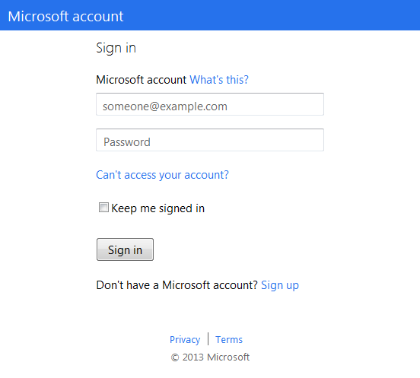
How Microsoft Azure Backup Works
1. Sign Up
Microsoft Azure
2. Install Agent
3. Register and Configure
4. Backup
Encrypted Data
Window Server 2012
5. Recover - to the same or a different server
Small Business or Branch Office

Slide 9


Network Efficiency
Customer Premises
1. Identify changed blocks
2. Compress
2. Compress
Efficient change tracking
Transfer only changed content
Compression for low bandwidth consumption
Observed 50-70%

Slide 10
Azure Backup Security
Customer Premises
Azure Backup
1. Identify changed blocks
2. Compress
3. Encrypt
256-bit encryption
4. Encrypted data in backup vault
In transit and at rest
Admin owns and manages keys
Notes:
Data is encrypted on the on-premises server/client/System Center Data Protection Manager machine using AES256 and the data is sent over a secure HTTPS link.
The data which is sent to Azure remains encrypted (at rest). We do not decrypt the backup data at any point.
The encryption key should be at least 16 characters.
A4 - The key used to encrypt the backup data is present only on the customer premises. We do not maintain a copy in Azure and do not have any access to the key. If the customer misplaces the key, We cannot recover the backup data.
All data is transferred over HTTPS.
Ensure firewall rules enable communication with the below URLs for seamless backup of on-premises to Azure and workload protection on Azure:
www.msftncsi.com
*.Microsoft.com
*.WindowsAzure.com
*.microsoftonline.com
*.windows.net
All backup data is encrypted (and decrypted) within the premises before sending to Azure.
Uses AES 256 encryption algorithm
PassPhrase (Encryption key, PEK) can be of any size between 16 to 1024 characters
Data encrypted using machine generated key
Key is encrypted using PEK and stored on Azure with each recovery point
Customer changes PEK
All encrypted keys are brought back to on-premises
Decrypted and re-encrypted with new PEK
Stored updated encrypted keys with each RP
Supports Express Route
Azure Backup supports ISO 27001 and HIPAA. It is also certified to run in government cloud Fairfax and China Mooncake.
For more information, see: Azure Trust Center - https://www.microsoft.com/en-us/TrustCenter/Compliance/default.aspx

Slide 11
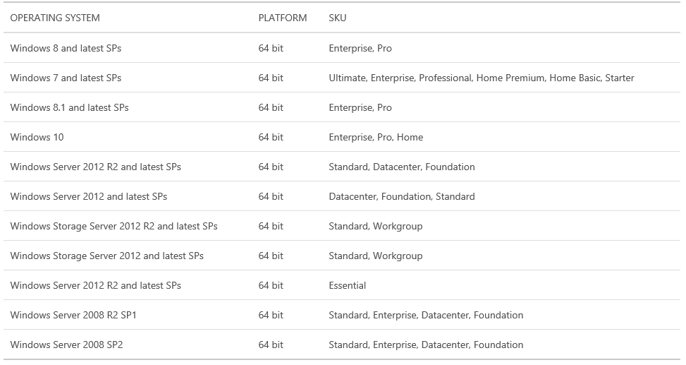
WAB Agent – Supported Platforms
https://azure.microsoft.com/en-us/documentation/articles/backup-azure-backup-faq/#installation-amp-configuration

Slide 12
Unsupported Scenarios
Vault to Vault migration not supported
Subscription to Subscription data migration not supported
Locally Redundant Storage (LRS) to Geo-redundant Storage (GRS) or vice versa migration not supported – configure vault before protection
Data cannot be recovered if encryption key is lost
The following set of drives/volumes cannot be backed up:
Removable Media: The drive must report as a fixed to be used as a backup item source
Read-only Volumes: The volume must be writable for the volume shadow copy service (VSS) to function
Offline Volumes: The volume must be online for VSS to function
Network share: The volume must be local to the server to be backed up using online backup
BitLocker protected volumes: The volume must be unlocked before the backup can occur
File System Identification: NTFS is the only file system supported for this version of the online backup service
Fiber Channel/iSCSI drives

Slide 13
Unsupported Scenarios (continued)
The following types are supported:
Hard Links: Not supported, skipped
Reparse Point: Not supported, skipped
Encrypted and Compressed: Not supported, skipped
Encrypted and Sparse: Not supported, skipped
Compressed Stream: Not supported, skipped
Sparse Stream: Not supported, skipped

Slide 14
Module 1: Introduction to Microsoft Azure Backup
Section 1: Prepare for WAB
Deployment Options

Slide 15
Enterprise and Branch Office Backup
Microsoft
Azure
Azure Backup
Solutions:
Cloud as tape replacement
Minimize local storage
Workload backup to Azure
Centralized management
Restore data to alternate server
Data Protection Manager or Azure Backup Server
Production Data

Slide 16
Which applications and workloads can be backed up?
Workload | Source machine | Azure Backup solution
Files and folders | Windows Server | Azure Backup agent, System Center DPM (+ the Azure Backup agent), Azure Backup Server (includes the Azure Backup agent)
Files and folders | Windows client | Azure Backup agent, System Center DPM (+ the Azure Backup agent), Azure Backup Server (includes the Azure Backup agent)
Hyper-V virtual machine (Windows) | Windows Server | System Center DPM (+ the Azure Backup agent), Azure Backup Server (includes the Azure Backup agent)
Hyper-V virtual machine (Linux) | Windows Server | System Center DPM (+ the Azure Backup agent), Azure Backup Server (includes the Azure Backup agent)
Microsoft SQL Server | Windows Server | System Center DPM (+ the Azure Backup agent), Azure Backup Server (includes the Azure Backup agent)
Microsoft SharePoint | Windows Server | System Center DPM (+ the Azure Backup agent), Azure Backup Server (includes the Azure Backup agent)
Microsoft Exchange | Windows Server | System Center DPM (+ the Azure Backup agent), Azure Backup Server (includes the Azure Backup agent)
Azure IaaS VMs (Windows) | - | Azure Backup (VM extension)
Azure IaaS VMs (Linux) | - | Azure Backup (VM extension)

Slide 17
Limitations – IaaS VM Backups
The following backup scenarios are not supported:
Backup of virtual machines with more than 16 data disks is not supported
Backup of virtual machines using Premium storage is not supported
Backup of virtual machines with multiple reserved IPs is not supported
Backup of virtual machines with a reserved IP and no end-point defined is not supported
Backup of virtual machines using multiple Network Interface Cards (NICs) is not supported
Backup of virtual machines in a load-balanced configuration (internal and internet-facing) is not supported
Backup of volumes with > 1TB of logical storage is not supported
Notes:
Replacing an existing virtual machine during restore is not supported. First delete the existing virtual machine and any associated disks, and then restore the data from the backup.
Cross-region backup and restore is not supported.
Virtual machine backup using the Azure Backup service is supported in all public regions of Azure. Here is a checklist (https://azure.microsoft.com/en-us/regions/#services) of supported regions. If the region you are looking for is unsupported today, it will not appear in the drop-down list during vault creation.
Virtual machine backup using the Azure Backup service is only supported for select Operating System versions:
Linux: The list of distributions endorsed by Azure is available here (https://azure.microsoft.com/en-us/documentation/articles/virtual-machines-linux-endorsed-distributions/). Other Bring-Your-Own-Linux distributions also should work as long as the VM Agent is available on the virtual machine.
Windows Server: Versions older than Windows Server 2008 R2 are not supported.
Restoring a domain controller VM that is part of a multi-DC configuration is supported only through Windows PowerShell.
For more information, see: https://azure.microsoft.com/en-us/documentation/articles/backup-azure-restore-vms/#restoring-domain-controller-vms

Slide 18
IaaS VM – Recovery Point Consistency
Application consistency
Ensures
That the VM boots up
There is no corruption
There is no data loss
The data is consistent to the application that uses the data, by involving the application at the time of backup - using VSS
File system consistency ensures
That the VM boots up
There is no corruption
There is no data loss
Crash consistency
No Guarantee
All data is collected at once
No memory contents or pending I/O transactions
Same state as power loss or system failure
Notes:
Application consistency
An application-consistent backup is the most involved but also the most desirable. Techniques vary, but the general process for Windows applications is for the application manufacturer to provide a VSS writer. When the VSS service is triggered, it will notify these writers that a backup is occurring. It is then up to the VSS writer how to handle it. In general terms, a database application will respond to its VSS writer being triggered by flushing all of its memory and I/O operations so that the database is completely consistent. In doing so, there is nothing in memory and no pending I/O to be lost. A proper VSS writer should effectively place all the data for an application in the same state it would be if the application were properly closed. When the VSS snapshot is complete, it signals the VSS writers, which are then to resume normal operation of the attendant application while the backup software safely copies the snapshot.
If an application does not provide or properly register a VSS provider but its data resides on a volume with VSS enabled, the data is backed up in a crash-consistent state.
VSS Coordination service - make sure the other components can communicate with each other properly
VSS Requestor=Windows BackUp Tool
VSS Writer - it guarantees that we have a consistent data set to backup.
VSS Provider - component that takes care of keeping the shadow copies after that consistent point in time
Using the backup software (VSS requester), you command the start of the database backup (creation of a shadow copy).
The database software (VSS writer) “freezes” the database, making sure that it is in a consistent state until further notice (hold your breath!).
The SAN hardware (VSS provider) creates a snapshot of the data.
The database software (VSS writer) is notified that the shadow copy is done and it is OK to write to the database again.
The backup software (VSS requester) indicates that the shadow copy was successfully created
File system consistency
There are two scenarios where the recovery point can be file-system consistent:
Backup of Linux VMs in Azure, since Linux does not have an equivalent platform to VSS.
VSS failure during backup for Windows VMs in Azure.
In both these cases, the best that can be done is to ensure that:
The VM boots up.
There is no corruption.
There is no data loss.
Applications need to implement their own "fix-up" mechanism on the restored data.
Crash Consistency
This situation is equivalent to a machine experiencing a "crash" (through either a soft or hard reset). This typically happens when the Azure virtual machine is shut down at the time of backup. For Azure virtual machine backup, getting a crash-consistent recovery point means that Azure Backup gives no guarantees around the consistency of the data on the storage medium - either from the perspective of the operating system or from the perspective of the application. Only data that already exists on the disk at the time of backup is what gets captured and backed up. While there are no guarantees, in most cases the operating system will boot. This is typically followed by a disk checking procedure like chkdsk to fix any corruption errors. Any in-memory data or writes that have not been completely flushed to the disk will be lost. The application typically follows with its own verification mechanism in case data rollback needs to be done. For Azure VM backup, getting a crash consistent recovery point means that Azure Backup gives no guarantees around the consistency of the data on the storage - either from the operating system perspective or the application's perspective. This typically happens when the Azure VM is shut down at the time of backup. As an example, if the transaction log has entries that are not present in the database, then the database software does a rollback till the data is consistent. When dealing with data spread across multiple virtual disks (like spanned volumes), a crash-consistent recovery point provides no guarantees for the correctness of the data.
Volume Shadow Copy Service (VSS)
A crash-consistent backup requires more effort on the part of backup software than inconsistent backups. The VSS was designed as a component of the operating system specifically to assist backup software. A backup application coordinates its efforts with VSS. When triggered, VSS pauses I/O on the volume and takes a block-level snapshot of it, and then the backup software pulls its backup from that snapshot at its leisure.
There are two methods for creating shadow copies—either making a complete copy of the data on a volume (thus creating a clone), or copying only the changes to the volume data (the copy-on-write method).
copy-on-write method
When a change to the original volume occurs (but before the write is made) the to-be-modified block is read and then written to a “differences area,” preserving a copy of the data block before it is overwritten with the change. This is commonly referred to as “copy-on-write.” With the blocks in the differences area and unchanged blocks in the original volume, a shadow copy can be logically constructed that represents the shadow copy at the point in time in which it was created.

Slide 19
Notes Continued
Notes:
Inconsistent Backup
Backup software starts at the beginning of the file structure and copies data until it gets to the end. If any file changed after it was backed up but before the job is completed, then the result is an inconsistent backup. Inconsistent backup method only grabs what is on the disk at the time; if a database has a pending operation in memory, it is completely lost.
Crash-Consistent Backup
The most important distinction between a crash-consistent backup and an inconsistent backup is that all data within a crash-consistent backup set is captured at exactly the same time. This is the most common method in use today and is almost always sufficient for applications that do not rely on a database. One thing it shares with the inconsistent method is that it does not capture the contents of memory or any pending I/O operations. If a crash-consistent backup is restored in its entirety, then the data will be in the same state it would have been if the system had crashed at the exact moment that the backup was taken. This is the reason it is considered “crash-consistent”.
Data on disk is “crash-consistent” if it is the same as it would be after a system failure or power outage.

Slide 20

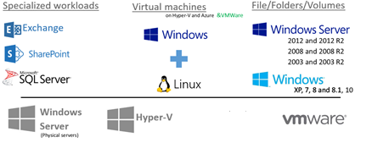

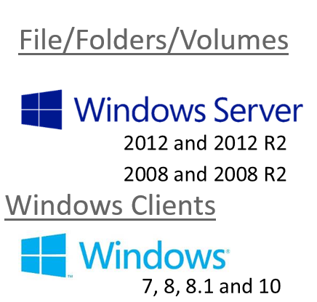
On-premises to Azure Deployment Models
Workload backup to Azure via System Center Data Protection Manager or Azure Backup Server
(D-D-C)
System Center Data Protection Manager
or
Azure Backup
Server
Microsoft
Azure
Azure Backup Service
Azure Backup Service
File/Folder backup to Azure (D-C)
Azure Backup
Agent
On-premises – built and managed infrastructure
Cloud – flexible, and remote infrastructure

Slide 21
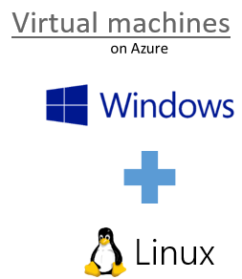
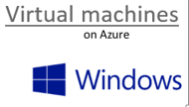
Deployment Models within Cloud
VM Extension
VM Extension
VM Extension
Microsoft
Azure
Azure Backup Agent
Azure Backup Service
Azure Backup Agent
System Center Data Protection Manager or
Azure Backup Server

Slide 22
Backup of Azure IaaS VMs
Microsoft Azure
Virtual machines
Cloud Data Backup
Value proposition:
Application consistent backup for MS workloads File System Consistent for Linux workloads
Fabric level protection
No additional customer resources required
Application consistent backup for MS workloads File System Consistent for Linux workloads
Fabric level protection

Slide 23

Azure IaaS VM Backup – How It Works
Azure Backup Vault
Azure IaaS VM
R3 | 1 | 2 | 3 | 4
Recovery Points
Backup
Extension
R2 | 1 | 2 | 3 | 4
R1 | 1 | 2 | 3 | 4
Snapshots
…
1
3
3
1
2
3
4
Disks
Data Blocks
Notes:
To back up a virtual machine, first a point-in-time snapshot of the data is needed. The Azure Backup service initiates the backup job at the scheduled time, and triggers the backup extension to take a snapshot. The backup extension coordinates with the in-guest VSS service to achieve consistency, and invokes the blob snapshot API of the Azure Storage service once consistency has been reached. This is done to get a consistent snapshot of the disks of the virtual machine, without having to shut it down.
After the snapshot has been taken, the data is transferred by the Azure Backup service to the backup vault. The service takes care of identifying and transferring only the blocks that have changed from the last backup – making the backup storage efficient. When the data transfer is completed, the snapshot is removed and a recovery point is created. This recovery point can be seen in the Azure management portal.
Capabilities
Backup VMs with 16 data disks (also the operating system disk).
Retain for longer periods using long-term retention solution.
Backup configuration is first with built-in backup policy – defined at vault creation time.
Job Reports.
Ability to configure and backup offline VMs.
Ability to cancel a long running backup/restore job.
Windows PowerShell to automate all tasks.
Alerts using Oplogs.
Best Practices
Protection of large number of VMs.
As each storage account have IOPS limitations, we suggest to configure all VMs with same protection policy spread across storage accounts.
For efficient and faster VM backups
Spread VM backups through out 24 hours
For smoother VM snapshots, we suggest to configure VMs across cloud services in a single policy
For more information, see: Capacity Planner - https://gallery.technet.microsoft.com/Azure-Backup-Storage-a46d7e33
Restoring a VM
Restoration of a VM to a cloud service should be done when no Create, Remove, Update and Delete (CRUD) operations in progress on any VMs of the same cloud services

Slide 24
Deployment Models
 | Characteristics
System Center Data Protection Manager and Azure Backup | Disk to disk to cloud backup - Faster operational recovery from disk backups (D to D to C) Requires additional server and local disks Workload backup (File/Folder, SQL Server, Exchange Server, SharePoint, Client, Hyper-V VM, VMware VM) Only System Center Data Protection Manager server needs internet connectivity Flexible backup schedule Central Backup Policy Enforcement (backup policy or encryption keys) Licensing tied to System Center Requires Azure subscription only to backup to Azure
Microsoft Azure Backup Server | Works just like System Center Data Protection Manager and Azure Backup except: Requires Azure subscription always Pay as you go license - tied to Azure subscription (SQL Server License bundled with Azure backup server) Cost effective for SMB No tape backup support Note: Can perform disk to disk backup (or) disk to disk to cloud backup - sending backup data to Azure is optional
Microsoft Azure Backup Agent (MARS agent) | No on-premises storage (D to C) No additional infrastructure needed File/folder protection only (no other workloads) Windows Servers require internet connectivity Self Service Backup and Recovery Maximum backups can be thrice a day and single backup policy per server No central enforcement of encryption keys or policy
Notes:
For more information, see: https://azure.microsoft.com/en-us/documentation/articles/backup-introduction-to-azure-backup/#deployment-scenarios

Slide 25
Module 1: Introduction to Microsoft Azure Backup
Section 1: Prepare for WAB
Getting Started – Step-by-step

Slide 26
Getting Started with Azure Backup – On-Premises
To back up files and data from your Windows Server to Azure, you must first:
Create a Backup vault — Create a vault in the Azure Backup console
To back up files and data from your Windows Server or System Center Data Protection Manager to Azure or when backing up Infrastructure as a Service (IaaS) VMs to Azure, you must create a backup vault in the geographic region where you want to store the data
Download vault credentials — In Azure Backup, upload the management certificate that you created to the vault
Install the Azure Backup Agent and register the server — From Azure Backup, install the agent and register the server in the backup vault
Notes:
Note: Previously you needed to create or acquire a X.509 v3 certificate in order to register your backup server. Certificates are still supported, but now to make Azure vault registration with a server easier, you can generate a vault credential right from the Quick Start page.

Slide 27
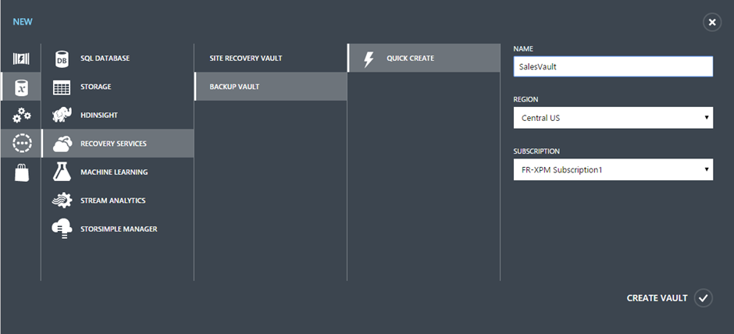
Create Azure Backup Vault (Classic)
Go to Azure Management Portal, https://manage.windowsazure.com
Browse the “+New” icon at the lowermost section
Create the backup vault with a name and choose a region

Slide 28
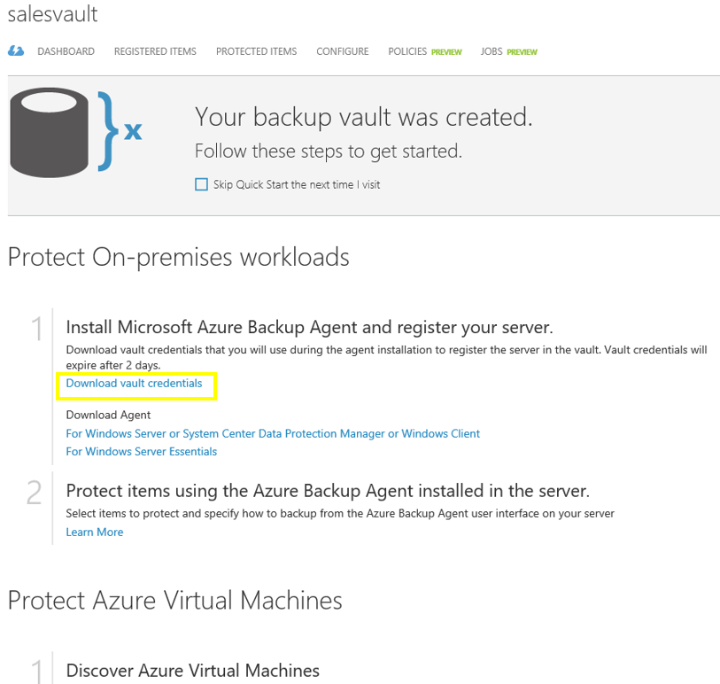
Download the Vault Credentials (Classic)
Navigate to Recovery Services
Click the Vault you created
Download Vault Credentials and Agent

Slide 29
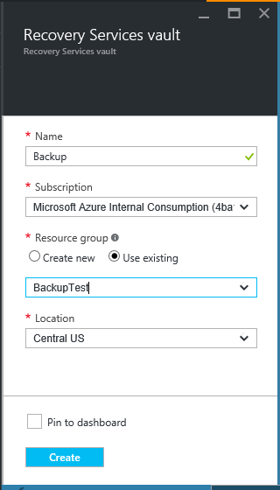
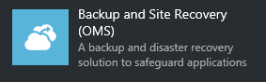
Create Recovery Services Vault (ARM)
Go to the Azure Portal https://portal.azure.com
Click the New icon in the top left corner
From the Management category choose Backup and Site Recovery (OMS)
Create the vault and choose a Resource Group and Location

Slide 30
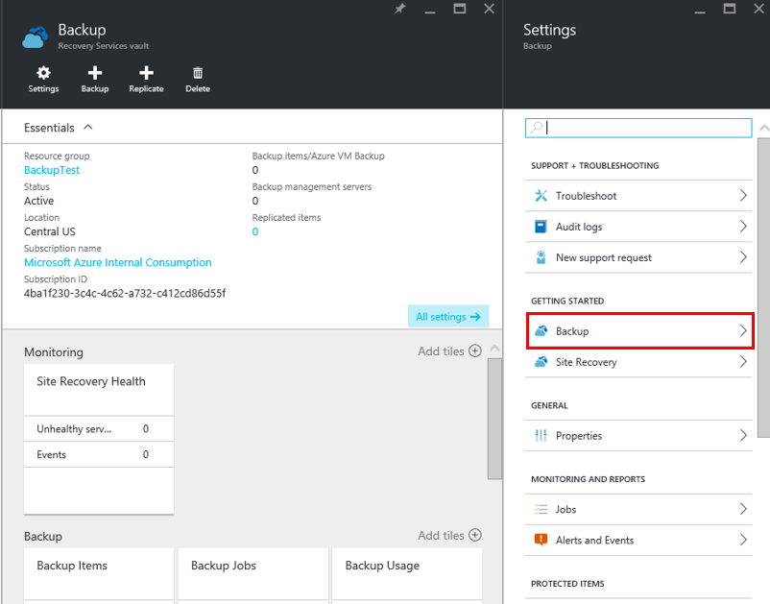
Getting Started
Use the Backup option on the Getting Started section on the Settings blade

Slide 31
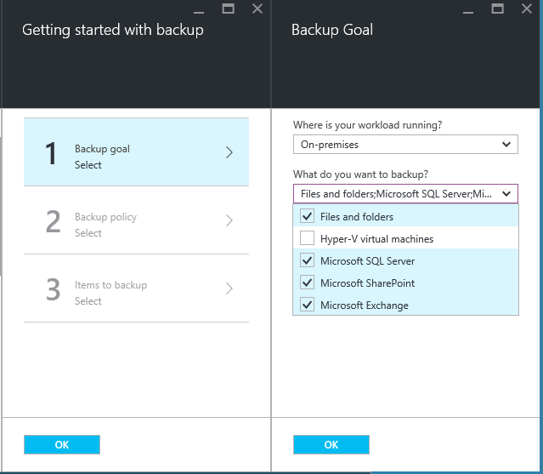
Backup Goal
Choose between On-Premises or Azure workloads
Select the type of items you wish to backup
Create a Backup Policy
Choose the objects to be backed up

Slide 32
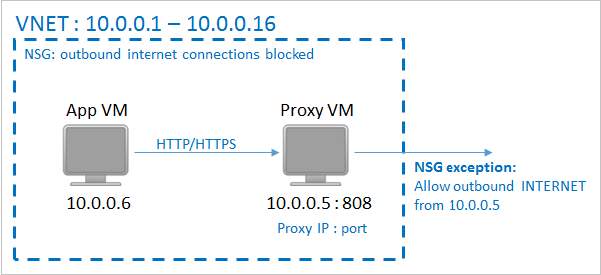
Network Connectivity for Azure Backup
Backup Extension connectivity to Azure Public IPs
Network Security Groups
HTTP Proxy
Notes:
The backup extension needs connectivity to the Azure public IPs to function correctly, because it sends commands to an Azure Storage endpoint (HTTP URL) to manage the snapshots of the VM. Without the right internet connectivity, these HTTP requests from the VM will time out and the backup operation will fail.
Network Security Groups - If your deployment has access restrictions in place (through a Network Security Group, for example), then you need to take additional steps to ensure that backup traffic to the Azure Backup vault remains unaffected.
There are two ways to provide a path for the backup traffic:
Whitelist the Azure datacenter IP ranges (https://www.microsoft.com/en-us/download/details.aspx?id=41653)
Deploy an HTTP proxy to route the traffic.
Using an HTTP proxy for VM backup - When backing up a VM, the snapshot management commands are sent from the backup extension to Azure Storage using an HTTPS API. This traffic must be routed from the extension through the proxy, since only the proxy will be configured to have access to the public internet.
In the example above, the App VM needs to be configured to use the Proxy VM for all HTTP traffic bound for the public internet. The Proxy VM needs to be configured to allow incoming traffic from VMs in the VNET. Finally, the NSG (named NSG-lockdown) needs a new Security Rule that allows outbound Internet traffic from the Proxy VM.
For more information, see: https://azure.microsoft.com/en-gb/documentation/articles/backup-azure-vms-prepare/

Slide 33
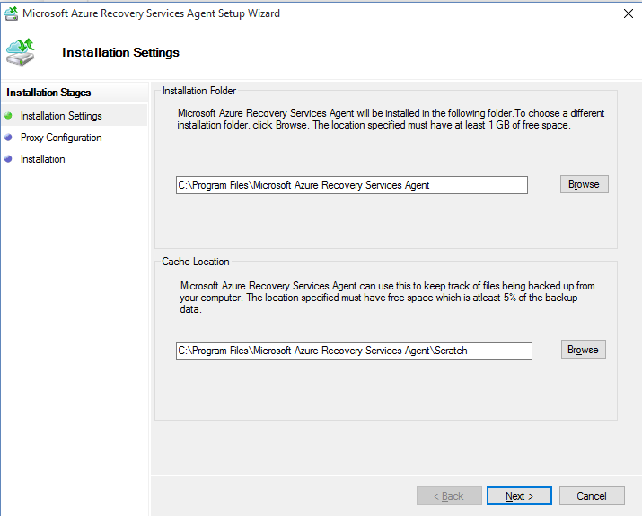
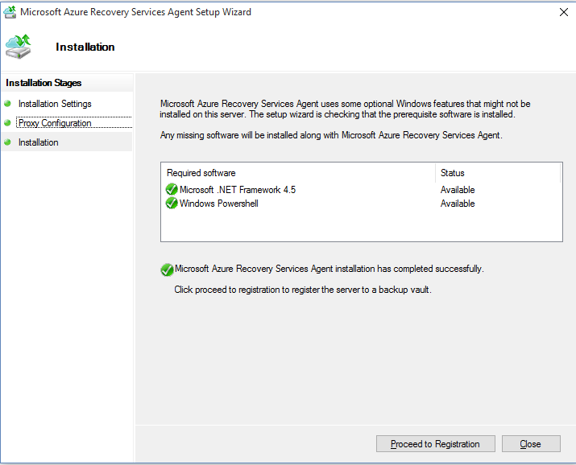
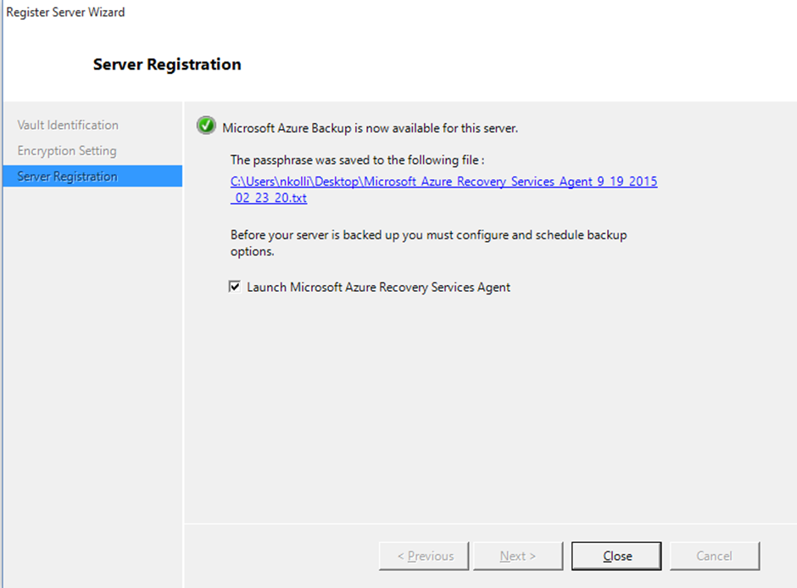
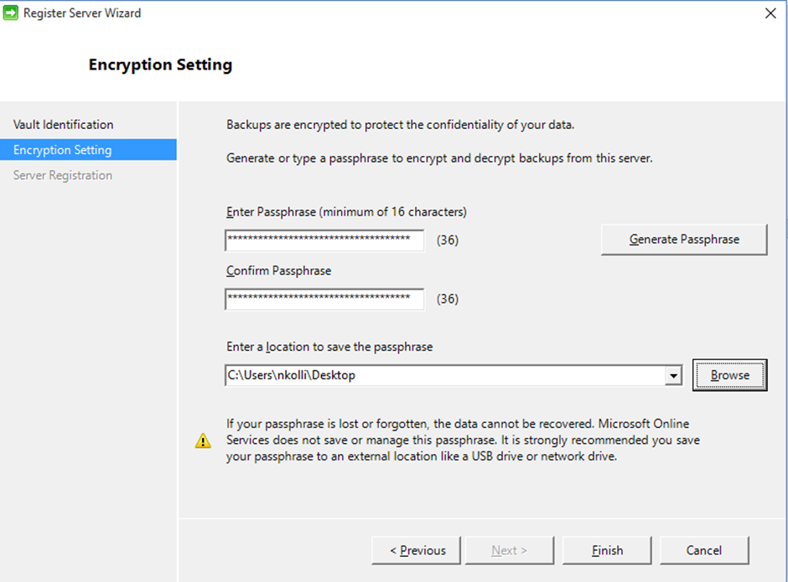
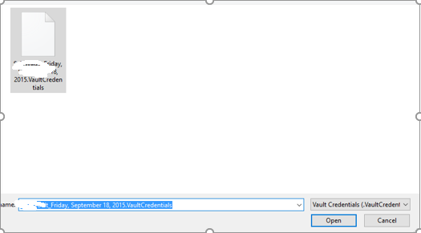
Register Your Server to Azure Backup Service
Install MARSAgent - MARSAgentInstaller.exe
Register the server
Create the PassPhrase Key
Complete the registration

Slide 34
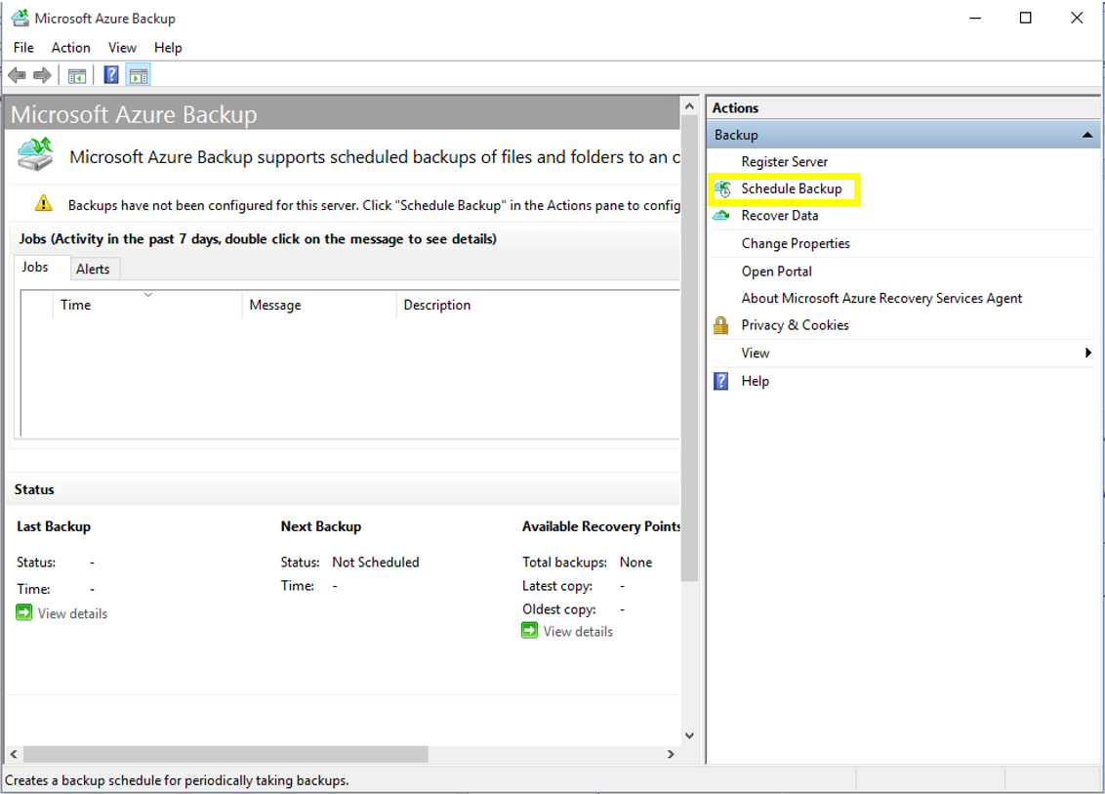
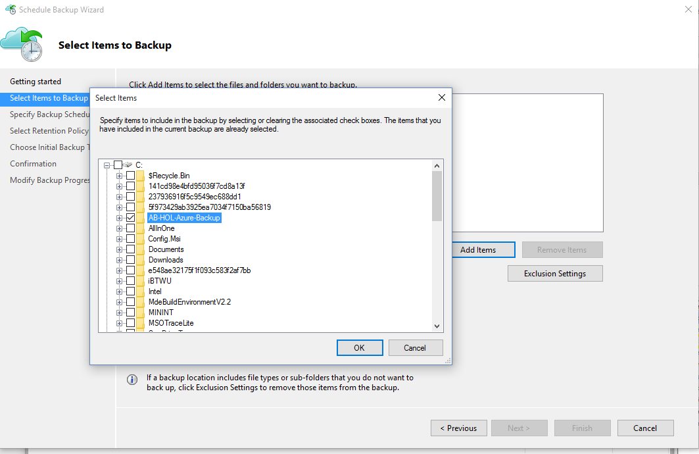
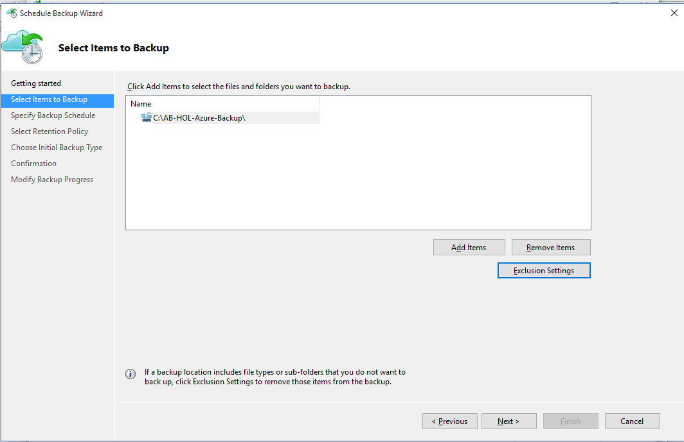
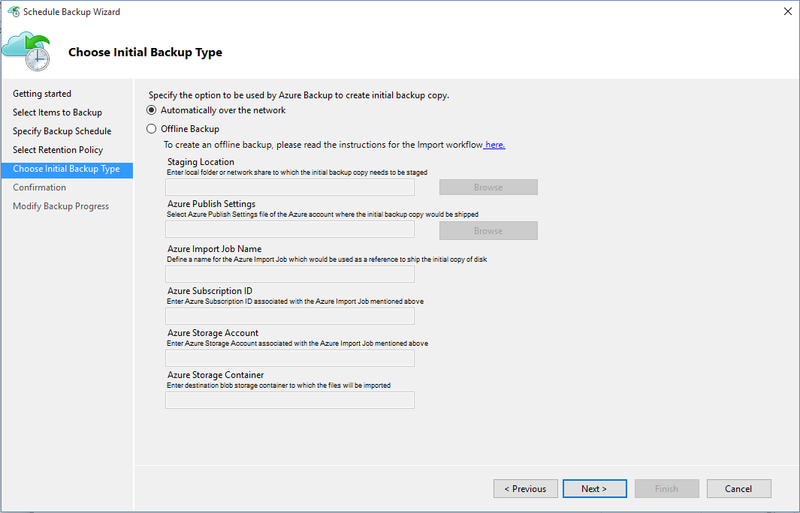
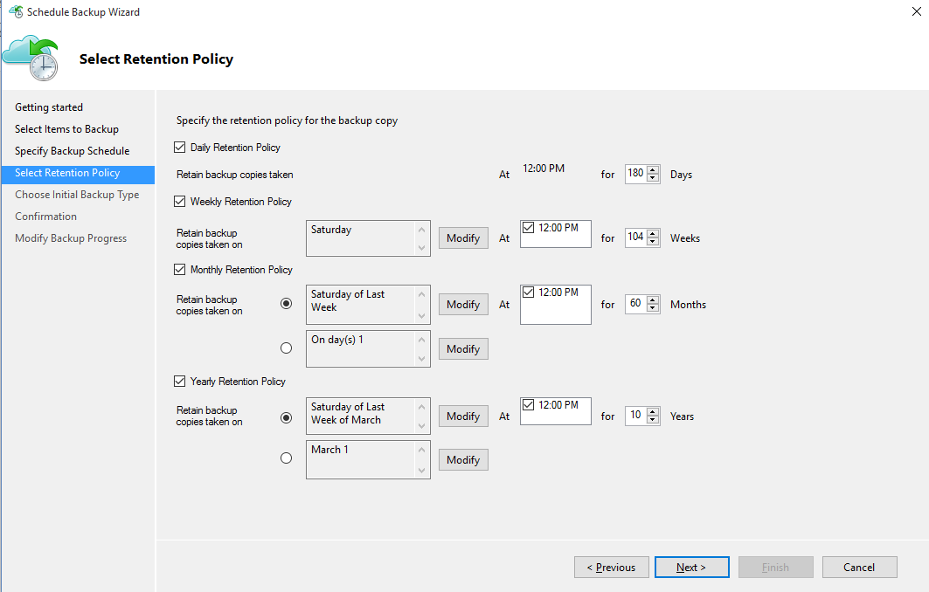
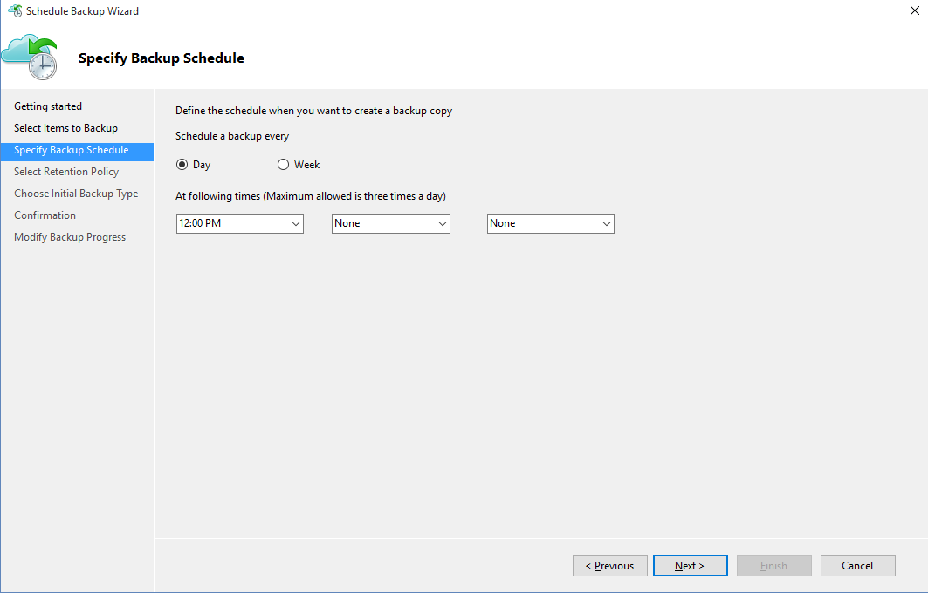
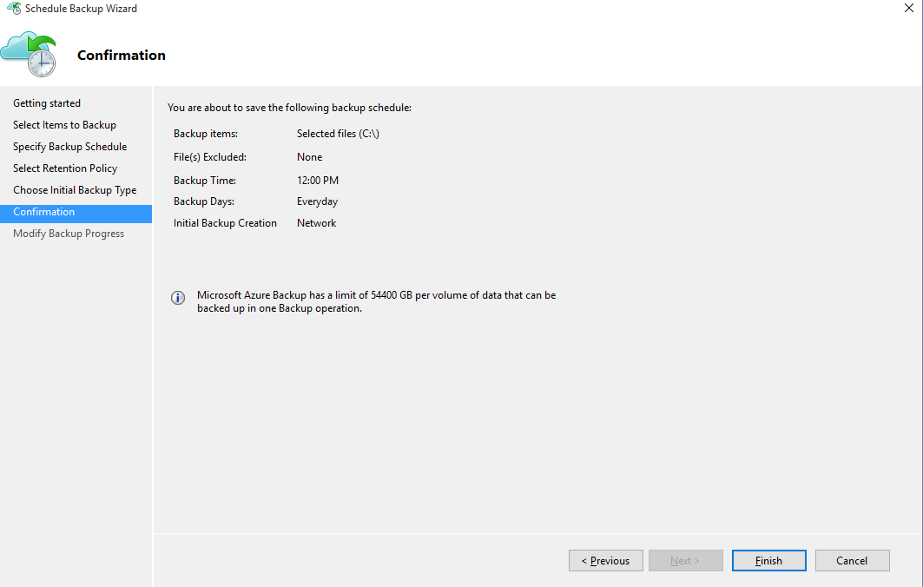
Protect Your Server
Start Azure Backup
Select the items to back up
Configure Exclusions
Specify the Date and Time
Specify Retention
Choose Backup Type
Notes:
Once the machine is registered, open the Microsoft Azure Backup mmc snap-in.
Select the items you wish to back up. Azure Backup on a Windows Server/Windows Client (that is without System Center Data Protection Manager) enables you to protect files and folders.
Specify the backup schedule and retention policy.
Choose the method for sending the initial backup. Your choice of completing the initial seeding is dependent on the amount of data that you wish to back up and your internet upload link speed. If you plan to back up GBs/TBs of data over a high latency, low bandwidth connection, we recommend that you complete the initial backup by shipping a disk to the nearest Azure data center. This is called “Offline Backup.”
After the schedule backup process is completed, go back to the mmc snap-in and click Back up Now to complete the initial seeding over the network.

Slide 35
Demo: Protect VMs with Azure Backup
Notes:
Speaker Notes:
Pre-Create Azure VM
Discovery VM
Register VM
Protect VM
Create a New Protection Policy

Slide 36
Lab 1: Azure Backup
Estimated Time: 45 Minutes
Lab 1-1: Protect Client with Microsoft Azure
Lab 1-2: Protect Azure IaaS VM
Lab 1-3: Protecting SQL Azure Databases - DPM
Lab 1-4: Restore Database using DPM

Slide 37
Module Knowledge Check
True or False: The Azure Backup Agent can be installed on a computer running Windows 2008 32-bit operating system
True or False: Application Consistency is supported for Linux Virtual Machines

Slide 38
Answers – Module Knowledge Check
True or False: The Azure Backup Agent can be installed on a computer running Windows 2008 32-bit operating system
False
True or False: Application Consistency is supported for Linux Virtual Machines
False

Slide 39
Module Summary
In this lesson, you learned:
The simplicity and efficiency of Microsoft Azure Backup
How to deploy, configure and manage Microsoft Azure Backup

Slide 40


